Slide 1

Unit V – EMERGING DATA HANDLING TECHNIQUES
Prof.Sonali Deshpande

Slide 2
Introduction to Big data, Handling large datasets using Map-Reduce and Hadoop, Paraquet file
Format, Introduction to Hbase data model and hbase region. Introduction to emerging database technologies- Cloud Databases, Mobile Databases, SQLite Database, XML Databases,Introduction of Apache spark,Features and uses of Apache spark

Slide 3

Introduction to Hbase
HBase is an open-source, column-oriented database which is built on top of the Hadoop file system.
Column-oriented databases are those that store data tables as sections of columns of data, rather than as rows of data.
It is a non relational database system(NoSQL).
HBase can store massive amounts of data from terabytes to petabytes.

Slide 4
Why use hbase?
Storing large amounts of data.
High throughput for a large number of requests.
Storing unstructured or variable column data.
HBase is used extensively for random read and write operations

Slide 5
Why Choose HBase?
A table for a popular web application may consist of billions of rows. If we want to search particular row from such a huge amount of data, HBase is the ideal choice as query fetch time in less. Most of the online analytics applications use HBase.
Traditional relational data models fail to meet performance requirements of very big databases. These performance and processing limitations can be overcome by Apache HBase.

Slide 6
HBase Data Model
The Apache HBase Data Model is designed to accommodate structured or semi-structured data that could vary in field size, data type and columns.
HBase stores data in tables, which have rows and columns.
Each table must have an element defined as Primary Key.
Row key acts as a Primary key in HBase.
Any access to HBase tables uses this Primary Key
Each column present in HBase denotes attribute corresponding to object

Slide 7
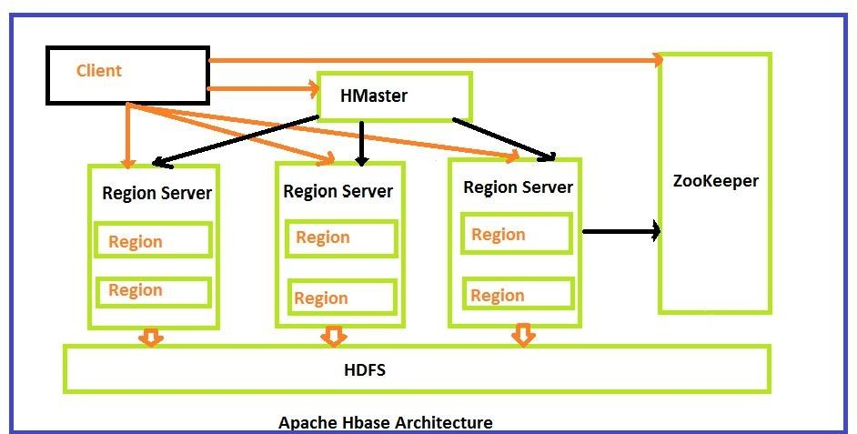
HBase Architecture

Slide 8
HBase architecture consists mainly of four components
Hmaster
HRegionserver
HRegions
Zookeeper

Slide 9
Hmaster
1. It acts as a monitoring agent to monitor all Region Server instances present in the cluster and acts as an interface for all the metadata changes.
2.Hmaster plays an important role in HBase .
3.It checks the performance of nodes in cluster.
4. Maintains the nodes in cluster as well.
5. It distributes services to different region servers.
6. HMaster assigns regions to region servers.
7. HMaster has the features like controlling load balancing and failover to handle the load over nodes present in the cluster.

Slide 10
Hregionserver
When Region Server receives writes and read requests from the client, it assigns the request to a specific region.
It is responsible for serving and managing regions or data that is present in a distributed cluster.
Client can directly contact to Hregion server for communication there is no need of permission oh Hmaster.
The client requires HMaster help when operations related to metadata and schema changes are required.

Slide 11
HRegions
HRegions are the basic building elements of HBase cluster that consists of the distribution of tables and are comprised of Column families.
It contains multiple stores, one for each column family. It consists of mainly two components, which are Memstore and Hfile.

Slide 12
Zookeeper
Zookeeper is a centralized monitoring server which maintains configuration information and provides distributed synchronization.
If the client wants to communicate with regions, the server's client has to approach ZooKeeper first.

Slide 13
HDFS
HDFS is a Hadoop distributed file system,it provides a distributed environment for the storage.
HDFS provides a high degree of fault –tolerance and runs on cheap commodity hardware.

Slide 14
HBase vs. HDFS
HBASE | HDFS
Low latency operations | High latency operations
Random reads and writes | Write once Read many times
Accessed through shell commands, client API in Java, REST, Avro or Thrift | Primarily accessed through MR (Map Reduce) jobs
Storage and process both can be perform | It's only for storage areas

